Slide 1

CS 533 INTRO TO DATA SCIENCE
Michael Ekstrand

Slide 2
A REAL EXAMPLE
Integrating Book Data

Slide 3

Learning Outcomes
See some of the data cleaning and integration decisions in a real data science project
Photo by Sharon McCutcheon on Unsplash

Slide 4

Question
Are book authors of different genders well-represented in user ratings and reviews ratings in online book platforms?

Slide 5



Data Requirements

Slide 6
Books
“Easy” public data:
Library of Congress Open MARC Data (10.5M records)
OpenLibrary (26.7M records)
GoodReads (crawled by UCSD; limited data)

Slide 7
MARC
Leader/00-23 *****nam##22*****#a#4500
001 <control number>
003 <control number identifier>
005 19920331092212.7
007/00-01 ta
008/00-39 820305s1991####nyu###########001#0#eng##
020 ##$a0845348116 :$c$29.95 (£19.50 U.K.)
020 ##$a0845348205 (pbk.)
040 ##$a[organization code]$c[organization code]
050 14$aPN1992.8.S4$bT47 1991
082 04$a791.45/75/0973$219
100 1#$aTerrace, Vincent,$d1948-
245 10$aFifty years of television :$ba guide to series and pilots, 1937-1988 /$cVincent Terrace.
246 1#$a50 years of television
260 ##$aNew York :$bCornwall Books,$cc1991.
300 ##$a864 p. ;$c24 cm.
500 ##$aIncludes index.
650 #0$aTelevision pilot programs$zUnited States$vCatalogs.
650 #0$aTelevision serials$zUnited States$vCatalogs.
Standard format for book and author data
Stores data in fields and subfields with numeric tags
Available in XML format
Same structure and tags
Easier to parse w/ standard tools
Still must know MARC fields!

Slide 8
What is a Book?
LoC catalogs many things:
Books
Periodicals
Government records
Music
Films
A “book” is:
Textual (MARC format ‘t’)
Also included ‘a’ (Map) to catch atlases
Not a government record

Slide 9
International Standard Book Number (ISBN)
Identifies books across publishers
Defined to identify a single edition of a book
Come in 10- and 13-digit formats
13-digit is variant of EAN
Can convert 10 to 13
Problems:
Many formats, surrounding text, etc.
Corrupt ISBNs
Extra digits
Missing digits
Incorrect check digit
Non-ISBNs in ISBN field
$15

Slide 10
Other Identifiers
Library of Congress Control Number (LCCN)
OpenLibrary edition & work IDs
GoodReads book & work IDs
Our own table primary keys
Amazon Standard Identification Number (ASIN)
Define unified book code – number identifying a book record

Slide 11
Real “ISBNs”
0836932722
013027190X (v. 2)
8719359022. ISBN 8719359004 (pbk.)
2890401448 : $5.00
$10.00
978-963-87472-2-8
0981482295 (978-0-9814822-9-3 : alk. paper)
0877030863 lib. bdg. (from label mounted on verso of t.p. correcting printed ISBN) (v. 1)

Slide 12
Cleaning ISBNs
Process ISBN fields:
Extract things that look like ISBNs
Digits, with allowable separators and terminating X
Long enough to be an ISBN
Extract “tags” (e.g. ‘pbk’)
Define allowable prefixes, postfixes, and separators
Clean junk and separators from inside ISBNs to standardize
Recursive descent parser driven by regular expressions (CS 361 & 354!)

Slide 13
Development Process
Start with simple rules
Manually verify some matches
Look for patterns not yet matched
Add to matcher!
Make ignore patterns for known-unparsable patterns
Iterate until everything is matched, ignored, or unusable

Slide 14
OpenLibrary
JSON – much easier to work with
Shares many ISBN problems – used same logic

Slide 15



What is a Book?
Books have multiple editions
Different publishers
Different ISBNs
Ratings / reviews usually attached to a single edition
OpenLibrary, GoodReads group into “work”
Not complete
Some records more complete than others
Best to recommend works

Slide 16
Grouping by Connected Components
Book
ISBN
Work
Book
ISBN
Work
Book
ISBN
Book
Each connected component gets a cluster identifier

Slide 17
Problems with Grouping
Miss groups when we don’t have records to link them
ISBN that never appears in any book data
Over-grouping when ISBNs are mislinked
ISBN erroneously recorded for wrong book
Two books’ ISBNs corrupted to same value
ISBN reuse
Combined volumes
Not yet good solutions – documented as limitation

Slide 18
Integration So Far
Book data from 3 sources
ISBNs (and ASINs) extracted
Book records mapped into clusters
ISBN ⇔ cluster mapping (what ISBNs are in a cluster?)
This is (complex) pooling, but w/o standardization
Next: linking!

Slide 19
Book Ratings and Reviews
Collected from online platforms:
BookCrossing [BX] (collected from an old book rating site, often used for recommender systems research)
Amazon [AZ] (public ratings and reviews, collected by UCSD in 2014)
GoodReads [GR] (ratings, reviews, and add-to-shelf actions by users with public profiles, collected by UCSD in 2017)

Slide 20
BookCrossing and Amazon Linking
BX: user ID, ISBN, rating
ISBNs can be corrupt – remove invalid chars
Link to book clusters
AZ: user ID, ASIN, rating, review text
Treat as ISBNs
Link to book clusters

Slide 21
GoodReads Linking
GoodReads contains:
User adds book to shelf (user ID, book ID, shelf ID, timestamp)
Shelf IDs not meaningful
“Is Read” flag for adding to the Read shelf
5-star rating (accompanying some add-to-shelf actions)
Review text (with user ID, item ID, timestamp, rating)
All have GoodReads book IDs – directly link to cluster

Slide 22
Integration So Far
LoC Book Records
BookCrossing Ratings
OpenLib Work Records
OpenLib Edition Records
Book Cluster
Amazon Ratings & Reviews
GoodReads Work Records
GoodReads Book Records
GoodReads Ratings, Adds, Reviews

Slide 23
Author Data
Book data includes list of authors
OpenLibrary & GoodReads have author entries
Linked identifiers
But we want author gender — missing!
Let’s not guess from names.

Slide 24
Authority Records
Librarians create two kinds of records:
Bibliographic records about books
Name authority records about authors
More MARC, and… MARC Authority field 375 is “gender”!

Slide 25
Recording Gender
MARC Authority Field 375:
Defined as gender identity
Uses an open vocabulary
Allows for multiple gender records per author with validity dates
Program for Cooperative Cataloging Working Group provides guidance on filling the field

Slide 26
Un-Recording Gender
Library of Congress
PCC coordinates contributing libraries
Some contributors do not record gender
Only covers LoC collections
Virtual Internet Authority File
Combines LoC with other national libraries
Smashes all gender records into male/female without dates

Slide 27
Linking Authority
MARC records do not have linking identifiers
Bibliographic record stores author name
Authority record has control number, but it isn’t referenced
OpenLibrary records VIAF control numbers for a few authors

Slide 28
Linking by Name
Find VIAF record(s) with names matching first author’s name
Extract gender identity field
Assumption: it is unlikely for two authors to have the same full name and different genders.
Combine all matching gender records into male, female, ambiguous, or unknown
Only reasonable because of goal/question

Slide 29
Names
Authority records list multiple name variants for an author
OpenLibrary also lists multiple names for author
Book only lists one
Inconsistent on “Family, Given” or “Given Family”
Solution:
If authority record has “B, A”, generate additional “A B” name
Accept match on any name

Slide 30
Integration
First Author Gender
LoC Book Records
BookCrossing Ratings
OpenLib Work Records
OpenLib Edition Records
Book Cluster
Amazon Ratings & Reviews
GoodReads Work Records
GoodReads Book Records
GoodReads Ratings, Adds, Reviews

Slide 31
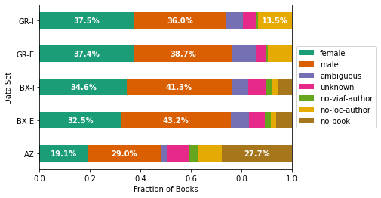
Measuring

Slide 32
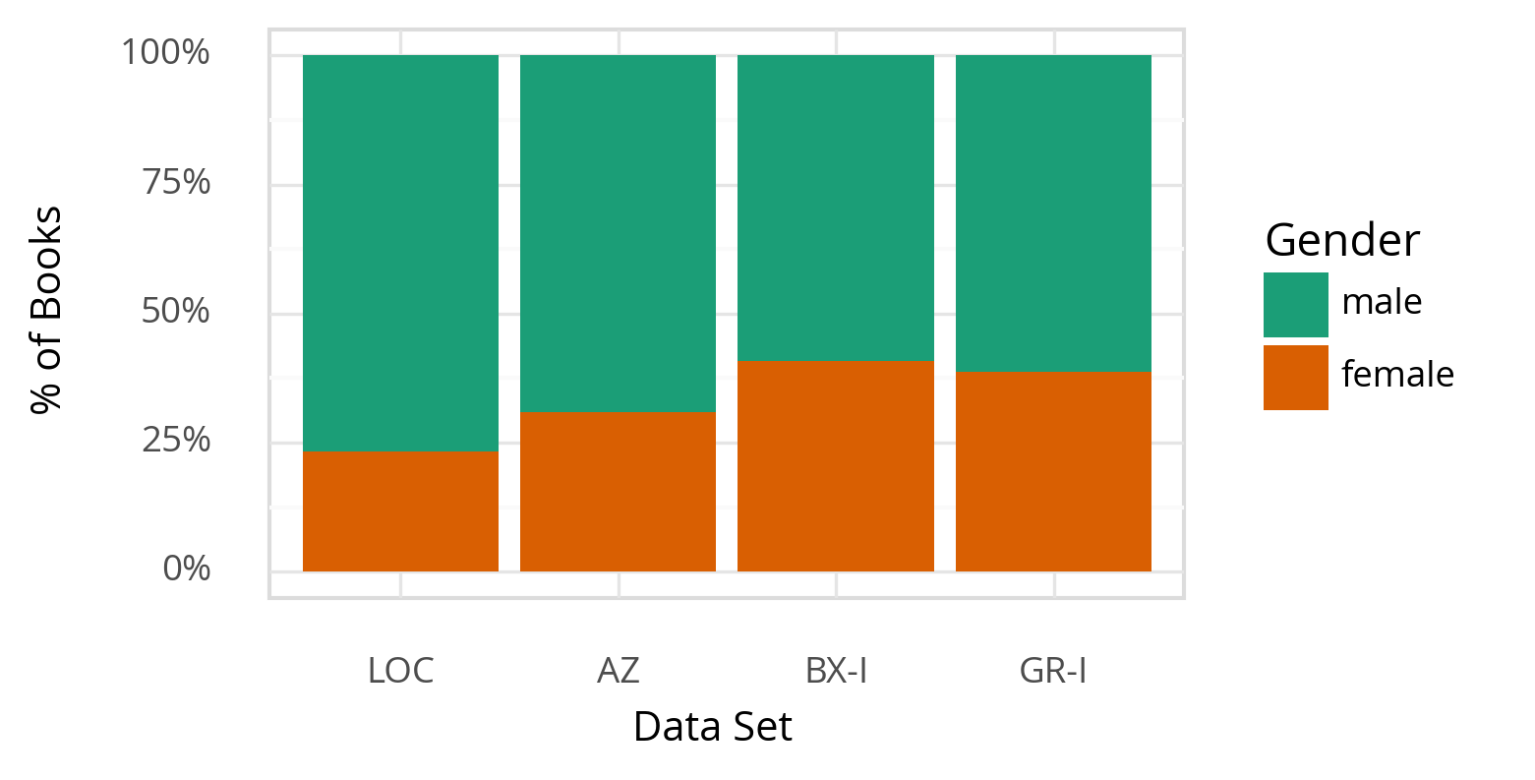
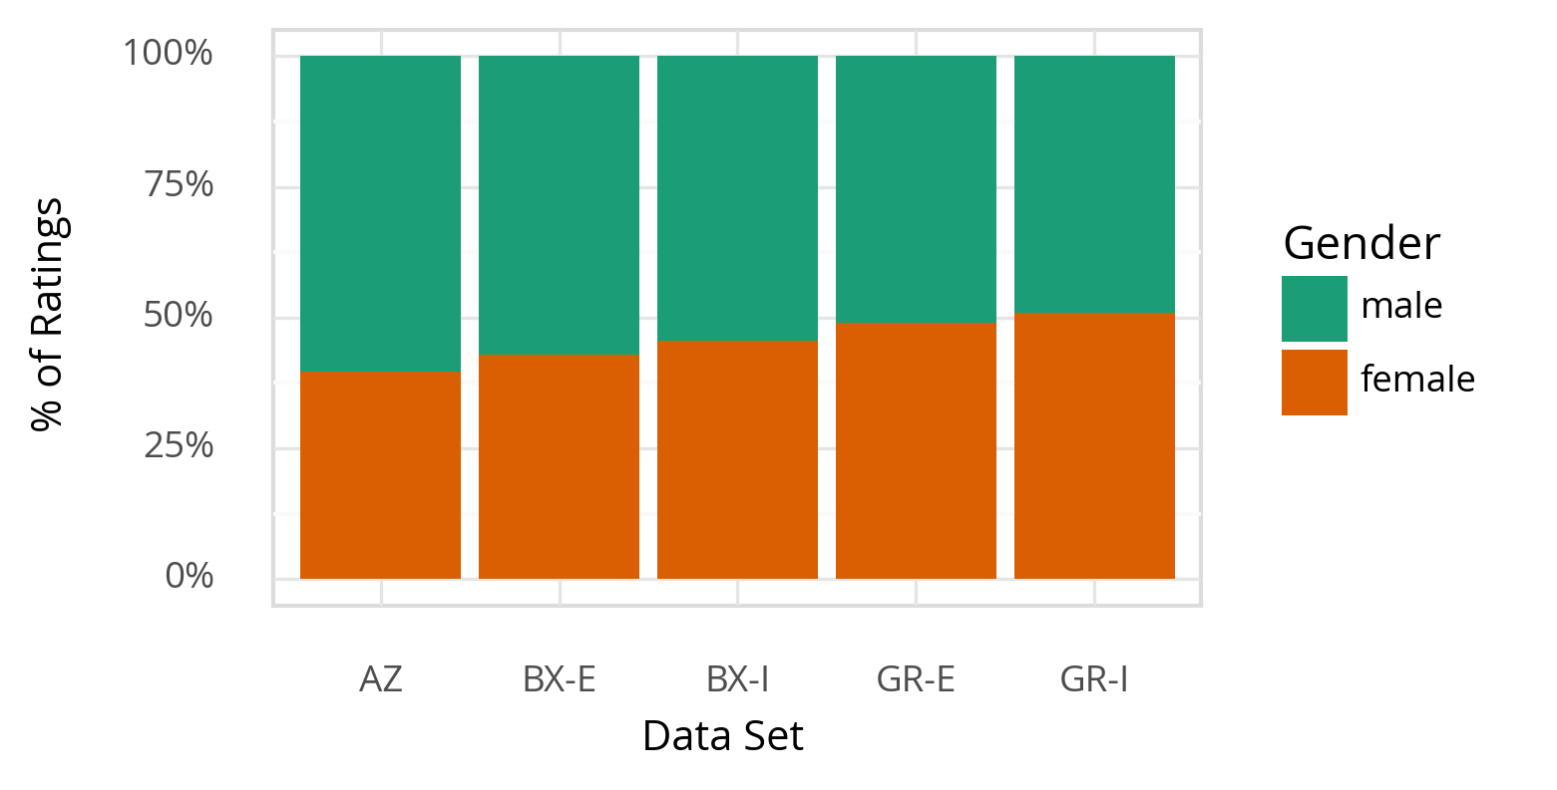
Representation

Slide 33
Limitations
Over-links authors, which can cause some gender errors
Over-links books, causing some gender and book errors
Only records binary gender
Unknown gender distribution of unknown books
Presence of the label is probably biased, we don’t know how
LoC has linked data that should help; not yet publicly available

Slide 34
Software
Rust program
Parses raw data files
Loads into SQL database
Cleans ISBNs
Rust:
Compiled language (fast like C)
High-level features (memory management, types, strings, XML parsers, etc.)
PostgreSQL
Stores data
Extracts desired fields from natural objects
Integrates data sources
Python
Clusters books
Computes statistics
DVC controls whole process

Slide 35

Wrapping Up
Many decisions go into a serious data integration project.
Document and justify them all.
Design workflow to make it transparent and reproducible.
Photo by Erol Ahmed on Unsplash

